Slide 1

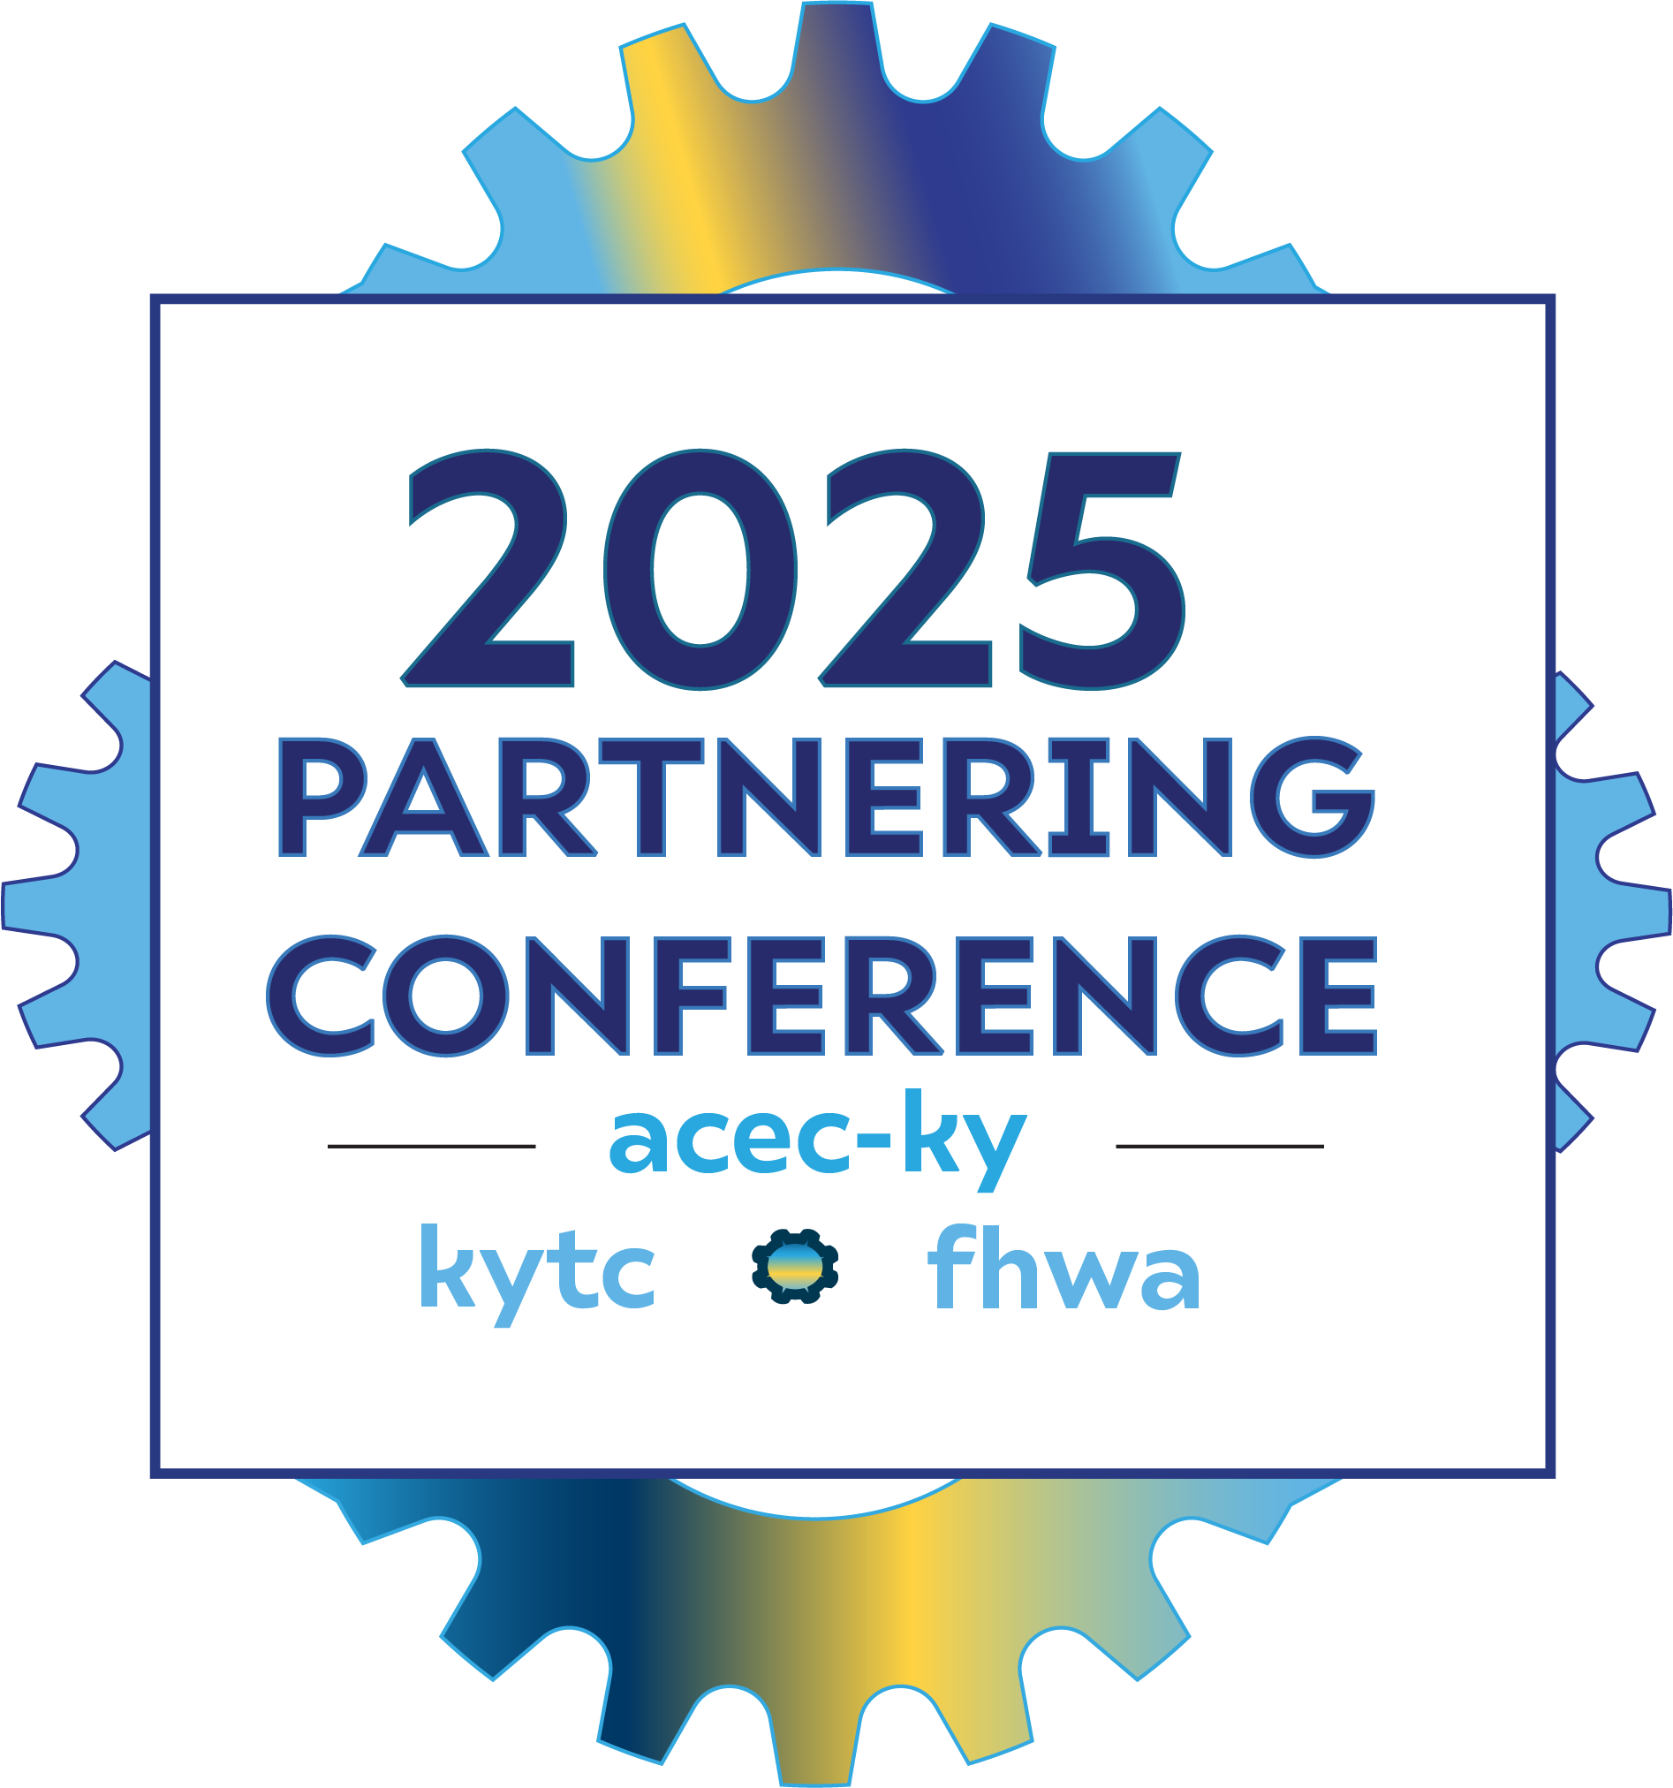
Just Double It!
Building Planning and Scoping Cost Estimates
Steve De Witte & Patrick Perry
September 4, 2025

Slide 2

​THE KYTC MISSION
To provide a safe, efficient, environmentally
sound and fiscally responsible transportation
system that delivers economic opportunity
and enhances the quality of life in Kentucky

Slide 3
Agenda
Cost Estimate Background
AASHTOWare Project Estimation Update
Recent examples – What Gets Missed?
Building a Scoping Estimate Together/Framework
Next Steps/Questions
Exchange Tearful Goodbyes

Slide 4

https://pe.app/

Slide 5
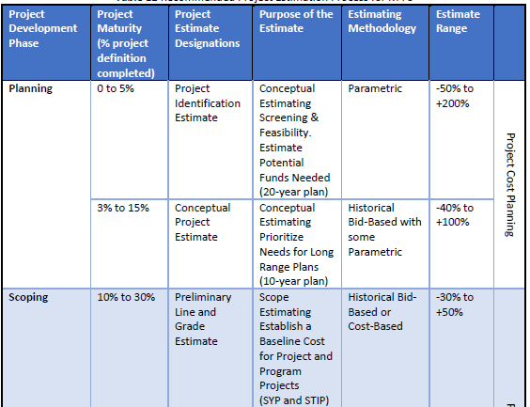
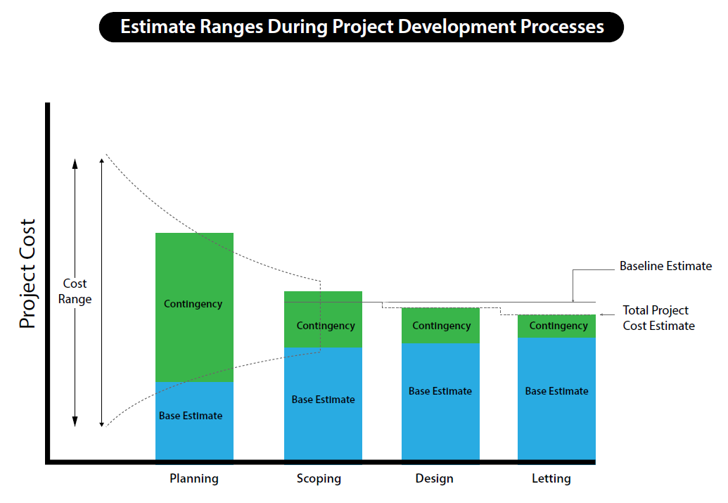
Cost Estimate Background

Slide 6
Cost Estimate Background

Slide 7
Cost Estimate Background

Slide 8
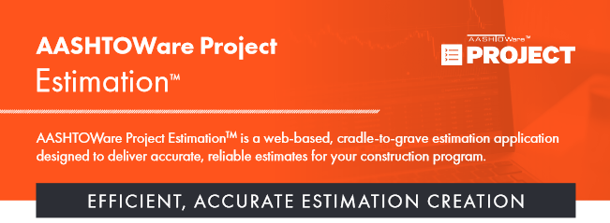
AASHTOWare Project Estimation Update

Slide 9
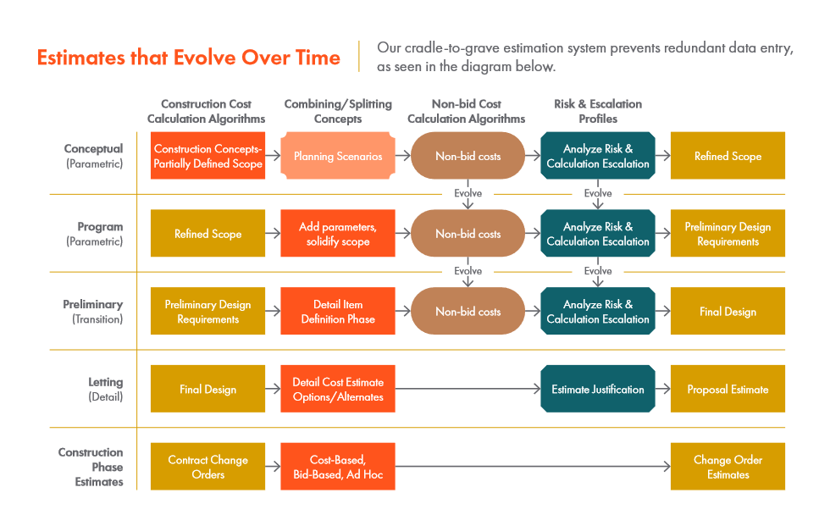

Slide 10
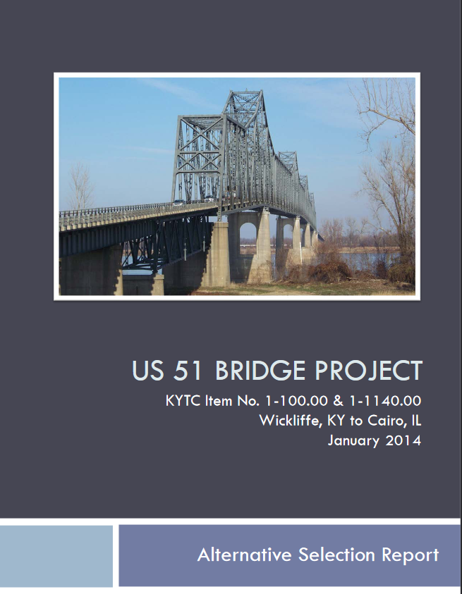
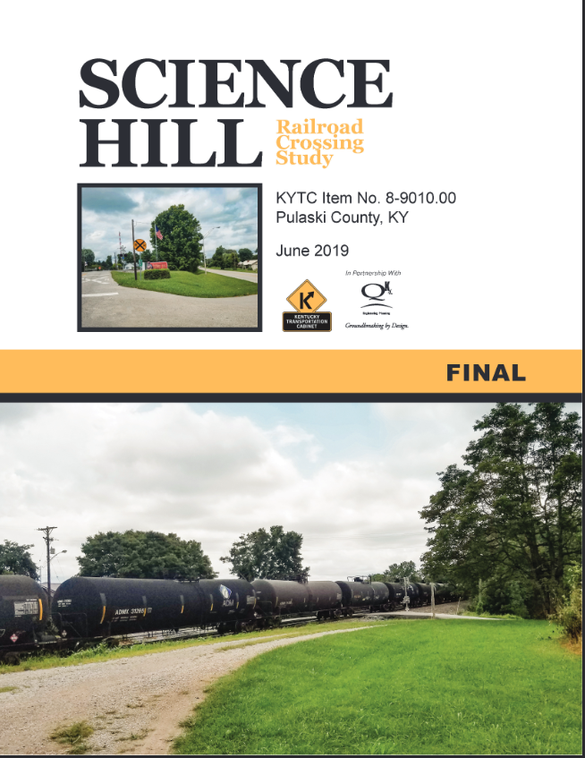
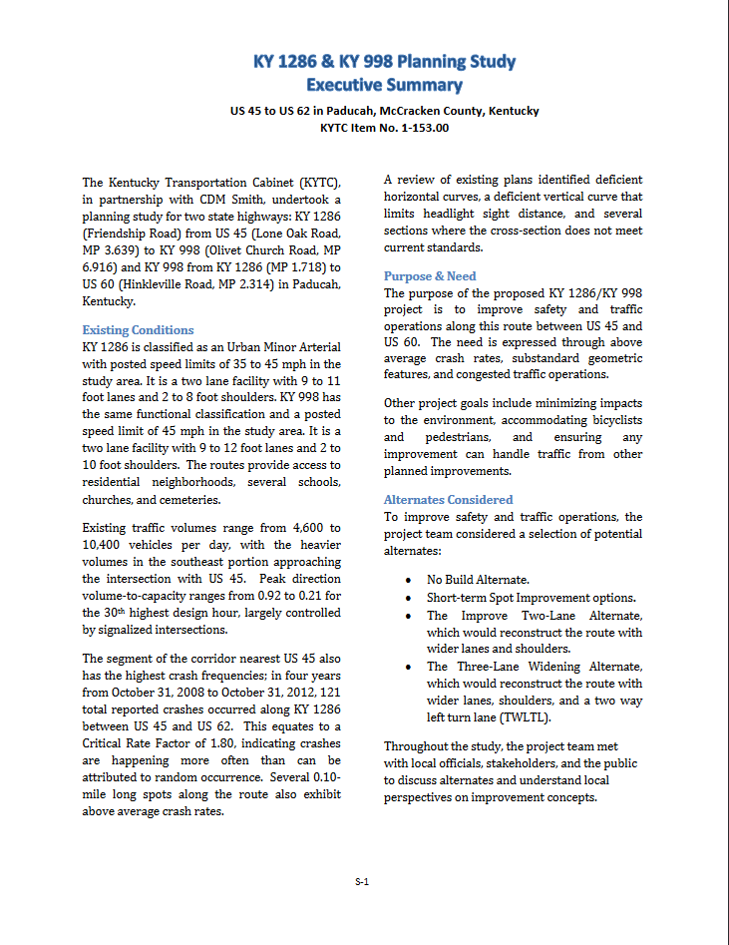
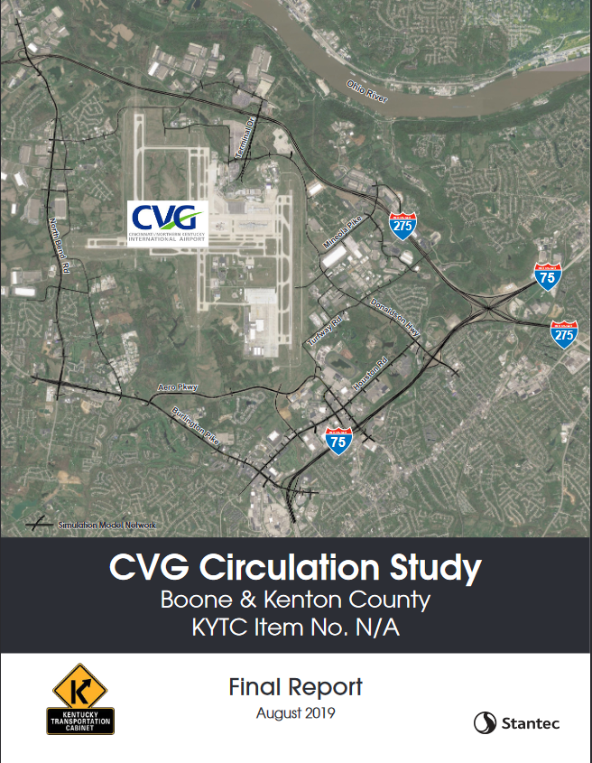
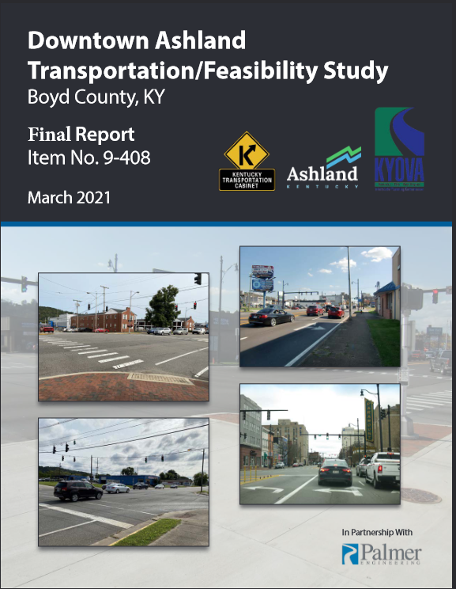
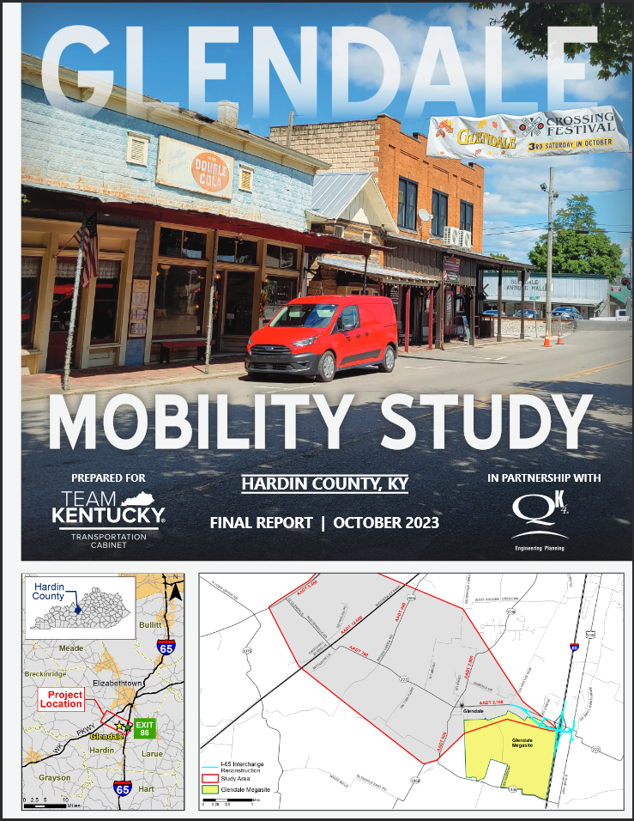
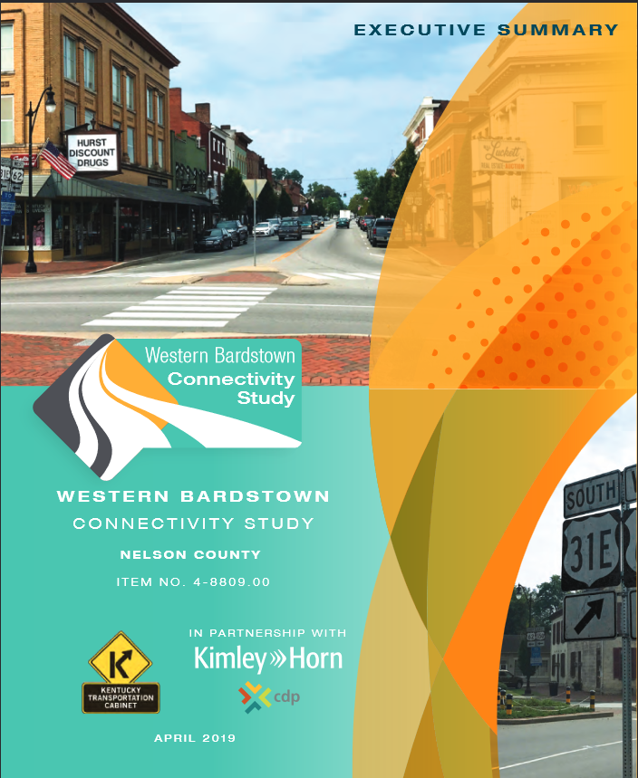
Recent Examples

Slide 11
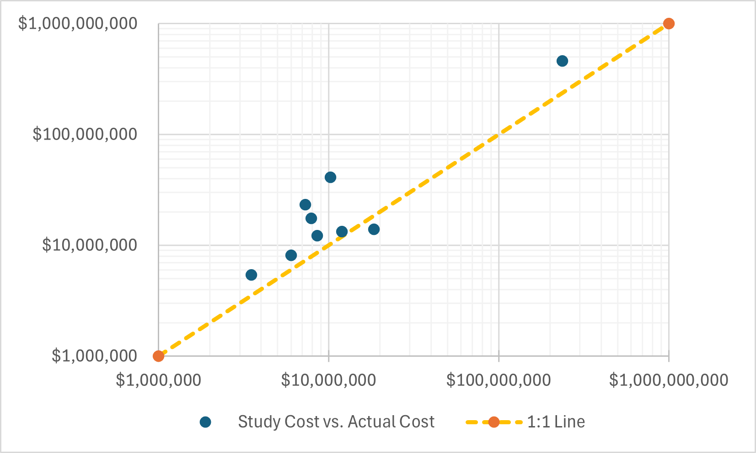
Straight Costs

Slide 12
Straight Costs
LESS
GOOD
GOOD

Slide 13
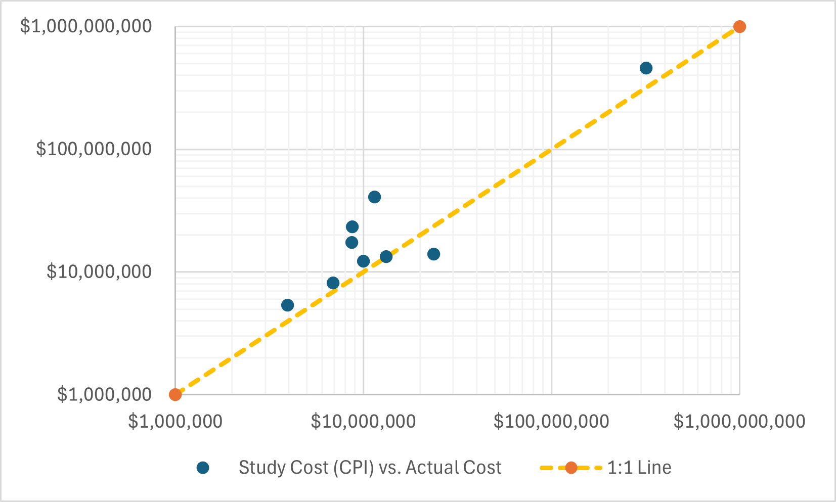
Grown with CPI
LESS
GOOD
GOOD

Slide 14
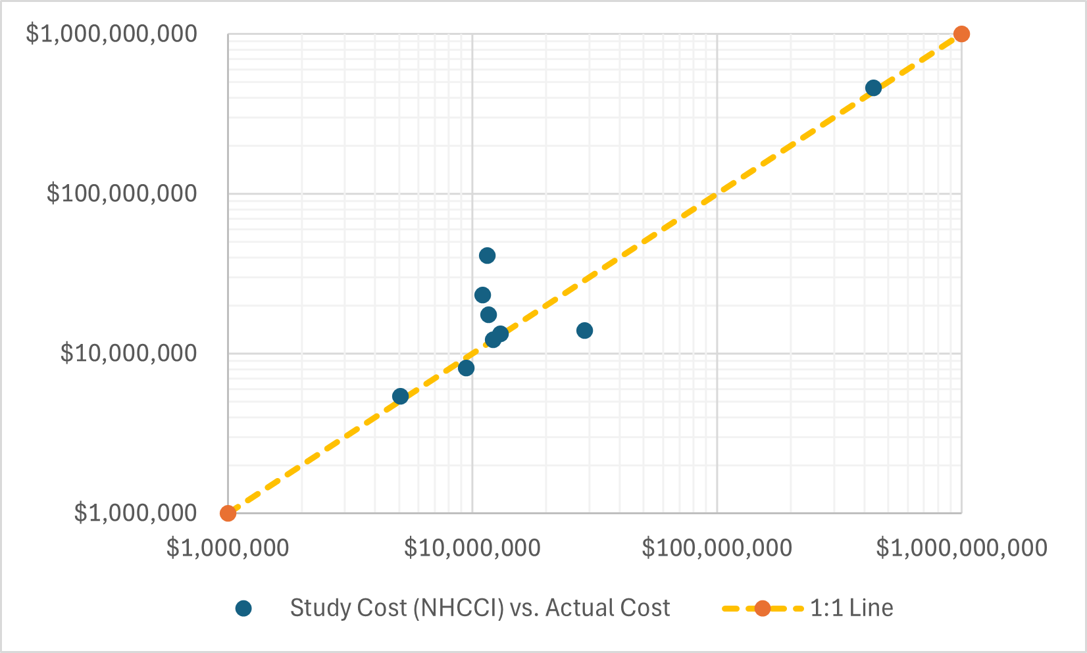
Grown with NHCCI
LESS
GOOD
GOOD

Slide 15
Year | CPI | NHCCI
2014 | 1.00 | 1.69
2015 | 1.00 | 1.66
2016 | 1.01 | 1.66
2017 | 1.04 | 1.65
2018 | 1.06 | 1.66
2019 | 1.08 | 1.87
2020 | 1.09 | 1.92
2021 | 1.14 | 1.86
2022 | 1.24 | 2.18
2023 | 1.29 | 2.78
2024 | 1.33 | 3.12
2025 | 1.36 | 3.23
Δ | 36% | 91%

Slide 16
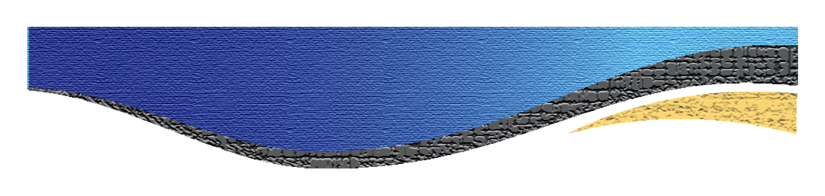
Building a Scoping Estimate Together/Framework
  Scope
  Quantities
  Parametric
  Standard Contingencies
  Risk-Based Contingencies
  Time/Management Risk

Slide 17
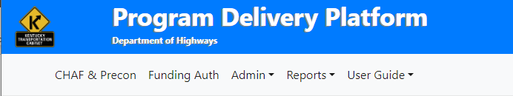
Not Escalation to a future year!
PDP does that:
4% YOY for D, U, C
5% YOY for R

Slide 18
Representative Example: Rural Route in District 9
Concept:
Reconstruct 4.9 miles
11’ lanes/8’ shoulders
Small sections of curb/gutter
10’ shared use path
1 bridge
1 railroad crossing (not feasible to grade separate)
1 traffic signal
45 potential parcels, 8 potential relocations
Utilities crisscross existing route
2024 SYP:
Only P in biennium, no other phases shown
Sponsored in SHIFT 2026 by District, single boost by BTADD

Slide 19
Easy Stuff First! What do we have bid-item quantities for?
Pavement
Excavation/Embankment
Striping
Curb & Gutter
Multi-Use Path
Guardrail & End Treatments

Slide 20
Easy Stuff First! What do we have bid-item quantities for?
Description | Depth (in) | lb/in/sq yd | Units |  | $ per Unit | Subtotal
CL2 ASPH SURF 0.38D PG64-22 | 1.5 | 110 | 0.08 | TON | $160.00 | $13.20
CL2 ASPH BASE 1.00D PG64-22 | 9.5 | 110 | 0.44 | TON | $140.00 | $61.60
CRUSHED STONE BASE | 18 | 115 | 1.04 | TON | $40.00 | $41.40
FABRIC-GEOTEXTILE CLASS 1 | 1 | -- | 1 | SQ YD | $3.00 | $3.00
TACK COAT |  |  | 0.075 | GAL | $36.54 | $2.74
PRIME COAT |  |  | 0.4 | GAL | $32.28 | $12.91
 |  |  |  |  | SUM | $134.85
 |  |  |  | SY | USE | $140.00

Slide 21
Easy Stuff First! What do we have bid-item quantities for?
Driving Pavement Costs
Total Length | 25,872 | LF
2 11' Lanes | 22 | LF
Area | 569,184 | SF
 | 63,243 | SY
Cost | $ 140
Subtotal | $ 8,853,973
Shoulder Pavement
Total Length | 25,872 | LF
2 @ 8' Wide | 16 | LF
Area | 413,952 | SF
 | 45,995 | SY
Cost | $ 140
Subtotal | $ 6,439,253
Total Paving | $ 15,293,227

Slide 22
Easy Stuff First! What do we have bid-item quantities for?
Other Bid Items | Qty | Units | $ per unit | Total
Clearing & Grubbing | 4.9 | mi | $250,000 | $1,225,000
Excavation | 963,425 | CY | $25 | $24,085,625
Guardrail | 13,125 | LF | $40 | $525,000
Guardrail End Treatments | 20 | EA | $4,500 | $90,000
Mill & Overlay (tie ins) | 1,617 | SY | $16 | $25,872
Pavement Striping | 25,872 | LF | $5 | $129,360
10' Shared Use Path | 28,747 | SY | $60 | $1,724,800
Curb & Gutter | 250 | LF | $60 | $15,000
 |  |  | Subtotal | $27,820,657
Bid-Item Cost: $43,113,884

Slide 23
Next: Parametric
Structures
Drainage
Signals
MOT
Mob/Demob
Phase Costs

Slide 24
Next: Parametric
Parametric Items | Qty | Units | $ per unit | Total
350’ long Bridge | 17,850 | SF | $400 | $7,140,000
Drainage/Erosion Control |  |  | 50% paving | $7,646,613
Maintenance of Traffic | 1 | LS | $500,000 | $500,000
Signals | 1 | EA | $1,000,000 | $1,000,000
 |  |  | Subtotal | $16,286,613

Slide 25
Next: Parametric
Phase Costs
  Design (comes later)
  ROW $9.2M (from District)
  Utilities $12M (from District)

Slide 26
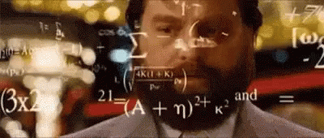
Paving | $15,293,227
Bid Items | $27,820,657
Parametric | $16,286,613
Total | $59,400,497
Mobilization (3%) | $1,782,015
Demobilization (1.5%) | $891,007
Construction w/o Contingency | $62,073,519

Slide 27
Next: Standard Contingencies
Blanket 25%? 30%? 50%?
What does it actually cover?
Will vary based on detail.

Slide 28
New: Risk-based Contingencies (risks to KYTC)
How likely to occur?
The railroad is CSX
Scope Changes
Surprise Utility conflict
Geotech issues
Carter County Commissioner’s Award
Environmental Mitigation
Unknown Unknowns (30%)
  How much do you know now vs. at PL&G?

Slide 29
New: Risk-based Contingencies (risks to KYTC)
Risk | Worst-Case Cost | Likelihood to Occur | Risk Cost
CSX Coordination
Flagger ($10k/day @ 365 days) | $3,650,000 | 65% | $2,372,500
Multiple Design Changes | $400,000 | 80% | $320,000
-----------------------------------
Scope Changes | $2,500,000 | 70% | $1,750,000
Surprise Utility Conflict | $2,500,000 | 50% | $1,250,000
Geotech Issues | $2,500,000 | 90% | $2,250,000
Carter County Commissioner Award | $1,800,000 | 75% | $1,350,000
Environmental Mitigation | $5,000,000 | 80% | $4,000,000
Unknown Unknowns (30%) | $18,622,056 | 100% | $18,622,056
 |  | Total Contingency | $31,914,556

Slide 30
New: Risk-based Contingencies (risks to KYTC)
Risk | Worst-Case Cost | Likelihood to Occur | Risk Cost
CSX Coordination
Flagger ($10k/day @ 365 days) | $3,650,000 | 65% | $2,372,500
Multiple Design Changes | $400,000 | 80% | $320,000
-----------------------------------
Scope Changes | $2,500,000 | 70% | $1,750,000
Surprise Utility Conflict | $2,500,000 | 50% | $1,250,000
Geotech Issues | $2,500,000 | 90% | $2,250,000
Carter County Commissioner Award | $1,800,000 | 75% | $1,350,000
Environmental Mitigation | $5,000,000 | 80% | $4,000,000
Unknown Unknowns (30%) | $18,622,056 | 100% | $18,622,056
 |  | Total Contingency | $31,914,556
At this point, add to C phase. We can always go back.

Slide 31
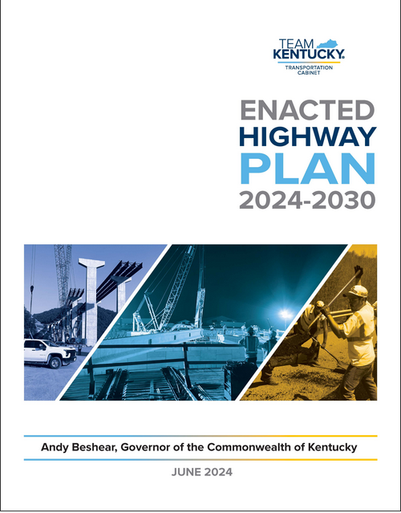
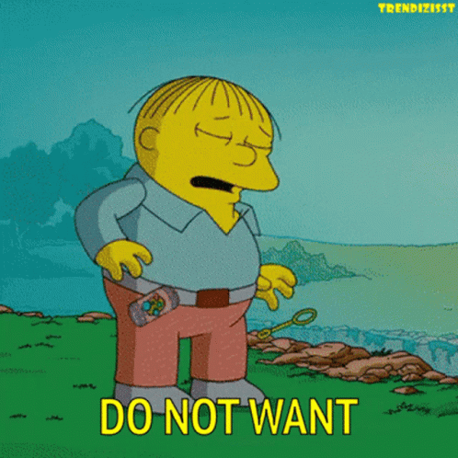
Are we done? No!!
We’re so not done I’m not even showing the new total.

Slide 32
Are we done? No!!
We’re so not done I’m not even showing the new total.
(but also 15% of that number for D phase estimate is ~$14.1M)

Slide 33
New: Time/Management Contingency (SYP risk)
We can’t even start design until (at earliest) 2026
  Which means R, U in 2028
  C in 2030
What things can hold this up?
  Rail, Utilities, ROW, Environmental
  Legislative Momentum
More likely case
    D in 2028
    R, U in 2030-2032
    C in 2034
The number we put down is going to hang around!

Slide 34
New: Time/Management Contingency (SYP risk)
Add 10-20% per biennium, per phase
Keep in Current Year Dollars
This is a contingency, not escalation
Design (in 2028):
$14.1M + 1 biennium away (15%) = $16.2M
ROW (in 2030):
$9.2M + 2 biennia away (30%) = $12.0M
Utilities (in 2032):
$12M + 3 biennia away (45%) = $17.4M
Construction (in 2034):
$94.0M + 4 biennia away (60%) = $150.4M

Slide 35
Phase | Cost (2025$ )
Design | $16,200,000
ROW | $12,000,000
Utilities | $17,400,000
Construction | $150,400,000
Total | $196,000,000

Slide 36
Phase | Cost (2025$ )
Design | $16,200,000
ROW | $12,000,000
Utilities | $17,400,000
Construction | $150,400,000
Total | $196,000,000
This goes into report, PDP, SYP

Slide 37


Slide 38
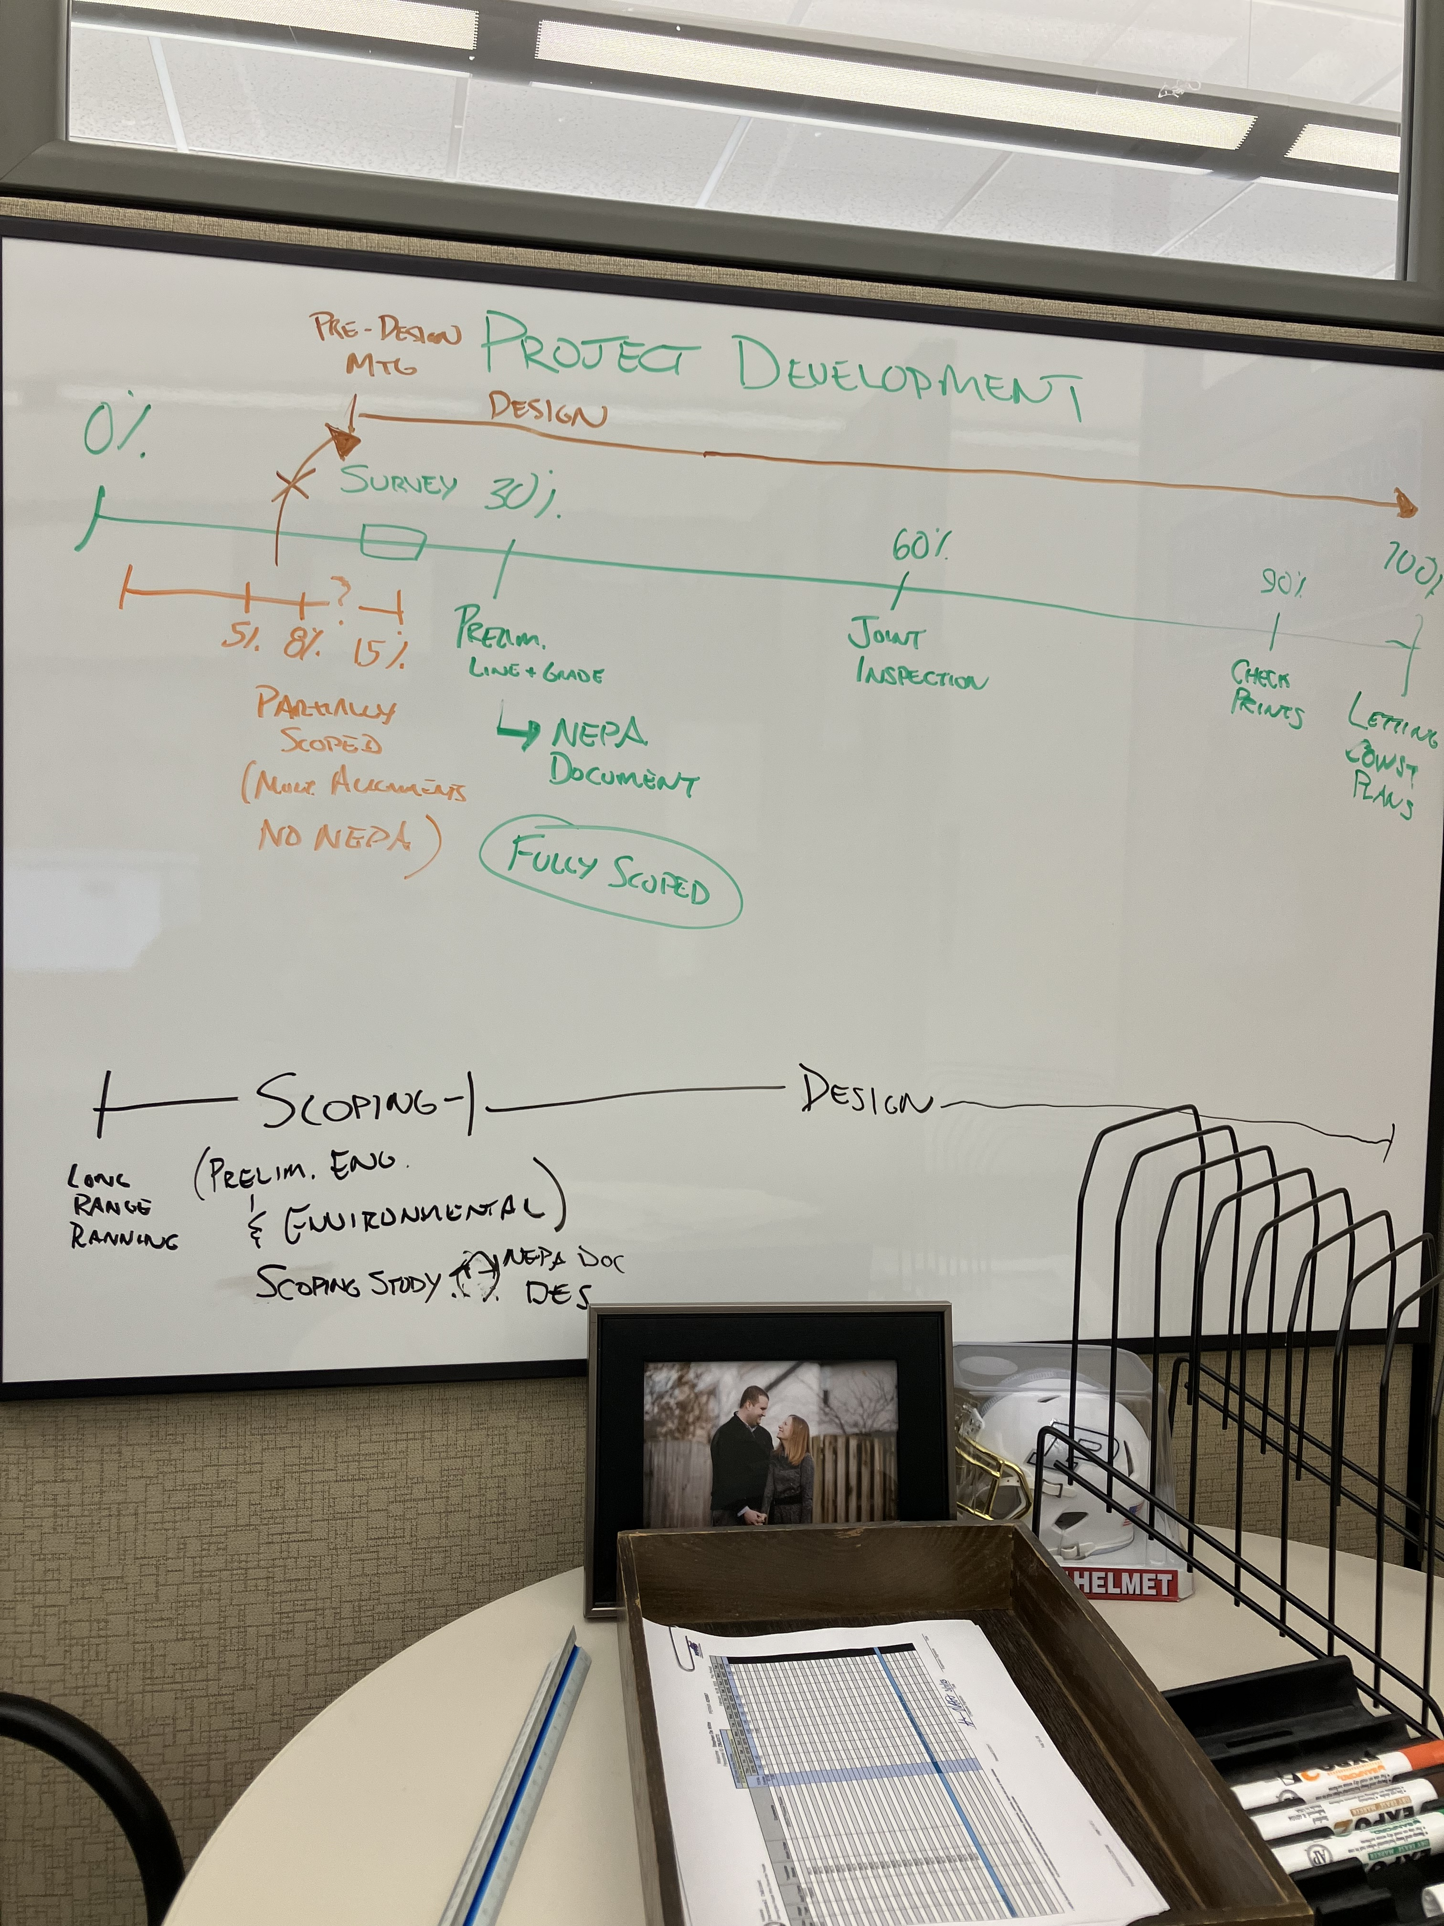
REVISIT ESTIMATE

Slide 39

Next Steps/Notes
Document, Document, Document
Pushback? Throw Steve Under Bus
Use estimates w/o Time/Management Contingency for B/C calcs
Risk Factor Research

Slide 40
https://pe.app/

Slide 41
QUESTIONS/DISCUSSION
Tearful goodbyes
Steve De Witte, P.E.
TE Branch Manager – Strategic Planning
Stephen.DeWitte@ky.gov
502-782-5056
Patrick Perry, P.E., P.L.S.
TE Branch Manager – Roadway Design
Patrick.Perry@ky.gov
502-782-4925

